Slide 1
Advanced Analytics Bootcamp
Module 5: Clustering Learning & Development

Slide 2
Over the next 1 hour, you will get an…
Overview of Clustering and Scenarios for Usage
A Deep Dive into K Means Clustering
A Deep Dive into Heirarchical Agglomerative Clustering

Slide 3
Clustering

Slide 4
Unsupervised Learning (1/4)
“Unsupervised” means that the training data has no ground truth labels to learn from
Supervised:
(chair)
(not a chair)
(not a chair)
chair?
(chair)
(not a chair)
(chair)
(not a chair)

Slide 5
Unsupervised Learning (2/4)
“Unsupervised” means that the training data has no ground truth labels to learn from
Unsupervised:

Slide 6
Unsupervised Learning (3/4)
“Unsupervised” means that the training data has no ground truth labels to learn from.
Unsupervised:

Slide 7
Unsupervised Learning (4/4)
“Unsupervised” means that the training data has no ground truth labels to learn from
This means they are much harder to evaluate
Clustering is an key unsupervised problem

Slide 8

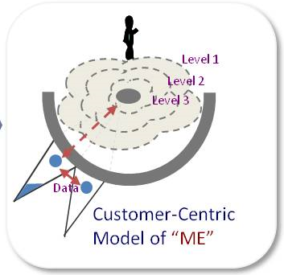
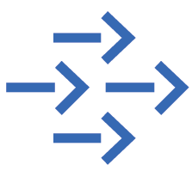
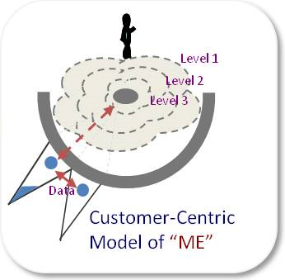
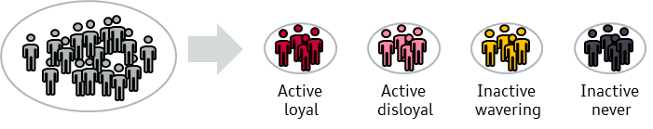
Why do we need to segment customers?
For enabling a tailored customer experience
For retaining the right customers
Customer Segments
Heterogeneous customers

Slide 9
Clustering
Applications include:
Automatically grouping documents/webpages into topics
For instance, grouping news stories from today into categories
Clustering large number of products
Clustering customers into those with similar purchase behavior
Notes:
jellyroll

Slide 10
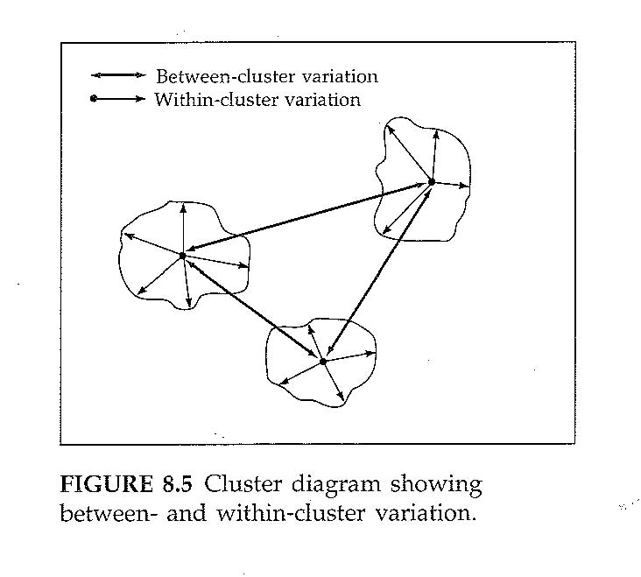
Cluster analysis as a method for segmentation
Segmentation
Cluster Analysis
In general segmentation groups objects based on their characteristics
Objects can be individuals, firms, countries, products, behaviors, etc., but mostly customers
Objects are grouped into segments such that objects in the same segment are as similar to each other as possible, and each segment is as different from each other as possible
Segment variables are divided into two groups:
Bases – characteristics that are used in deriving segments
Descriptors – characteristics that are not used directly in segmentation, but used to profile segments after these are developed using bases
Cluster analysis is the generic name for a wide variety of procedures that can be used to create a classification of objects
The essence of all clustering approaches is the classification of data by “natural” grouping of the data themselves
Good clustering algorithms maximize inter-cluster dissimilarity and intra-cluster similarity
Maximise between-segment variation
Minimise within-segment variation

Slide 11
K-means Clustering

Slide 12
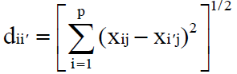
Deep Dive: The K-Means Clustering Algorithm (1)
K-Means Algorithm
Dimension A
K-means clustering is a method of cluster analysis which aims to partition n observations into k clusters in which each observation belongs to the cluster with the nearest mean
Only for metric input variables!
100
Algorithm
Given fixed parameter k
Randomly pick k instances as the initial centers
Assign the rest instances to closest one of k clusters
Recalculate the mean of each cluster
Repeat 3 & 4 until means don’t change
Limitations
Distance metric: simple
Cases - Euclidian distance
Means cannot be defined for categorical variables
Number of clusters need to be specified in advance
Sensitive to outliers and crisp clustering
0
Dimension B
100

Slide 13
Deep Dive: The K-Means Clustering Algorithm (2)
Dimension A
Randomly Initialize Clusters
100
0
Dimension B
100
Notes:
Stellen wir uns eine Segmentierung über zwei Dimensionen vor A und B mit einer Skala von 0 bis 100
Die Clusterzentren – der braune, blaue und violette Punkt werden zufällig im Raum verteilt

Slide 14
Deep Dive: The K-Means Clustering Algorithm (3)
Dimension A
Randomly Initialize Clusters
Assign data points to nearest clusters
100
0
Dimension B
100
Notes:
Die Individuen werden dem Clusterzentrum zugeordnet, der ihnen am nähesten ist

Slide 15
Deep Dive: The K-Means Clustering Algorithm (4)
Dimension A
Randomly Initialize Clusters
Assign data points to nearest clusters
Recalculate Clusters
100
0
Dimension B
100
Notes:
Nun wird der Schwerpunkt der Segmente berechnet und das Clusterzentrum dorthin verlagert

Slide 16
Deep Dive: The K-Means Clustering Algorithm (5)
Dimension A
Randomly Initialize Clusters
Assign data points to nearest clusters
Recalculate Clusters
Repeat…
100
0
Dimension B
100
Notes:
In einem nächsten Schritt wird überprüft, ob die Individuen immer noch dem Clusterzentrum zugeordnet sind, welchem sie am nähesten sind

Slide 17
Deep Dive: The K-Means Clustering Algorithm (6)
Dimension A
Randomly Initialize Clusters
Assign data points to nearest clusters
Recalculate Clusters
Repeat…
100
0
Dimension B
100
Notes:
Nun wird erneut der Schwerpunkt der Segmente berechnet und das Clusterzentrum dorthin verlagert

Slide 18
Deep Dive: The K-Means Clustering Algorithm (7)
Dimension A
Randomly Initialize Clusters
Assign data points to nearest clusters
Recalculate Clusters
Repeat…until convergence
100
0
Dimension B
100
Notes:
Dies erfolgt, bis es zu keinen signifikanten Veränderungen mehr kommt.

Slide 19
Strengths and Weaknesses of the k-means Algorithm
Strengths
Weaknesses
Simple: easy to understand and to implement
Efficient: Time complexity: O(tkn), where:
n is the number of data points,
k is the number of clusters, and
t is the number of iterations
Since both k and t are small. k-means is considered a linear algorithm
K-means is the most popular clustering algorithm
The algorithm is only applicable if the mean is defined
For categorical data, k-mode - the centroid is represented by most frequent values
The user needs to specify k
The algorithm is sensitive to outliers
Outliers are data points that are very far away from other data points
Outliers could be errors in the data recording or some special data points with very different values

Slide 20
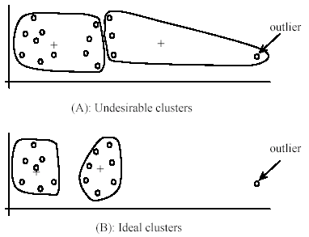
Weaknesses of k-means: Problems and Dealing with Outliers
One method is to remove some data points in the clustering process that are much further away from the centroids than other data points
To be safe, we may want to monitor these possible outliers over a few iterations and then decide to remove them
Another method is to perform random sampling Since in sampling we only choose a small subset of the data points, the chance of selecting an outlier is very small
Assign the rest of the data points to the clusters by distance or similarity comparison, or classification

Slide 21
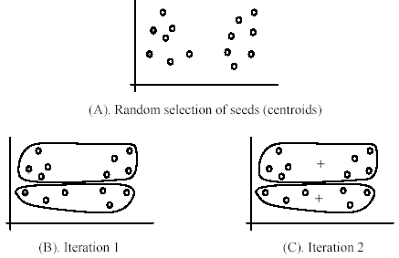
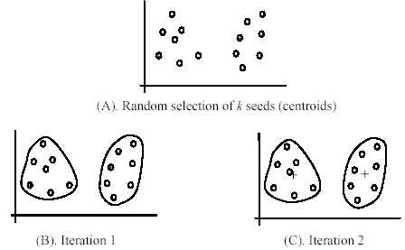
Weaknesses of k-means: Initial Seeds Sensitivity
The algorithm is sensitive to initial seeds
Using different seeds can give good results
There are some methods to help choose good seeds

Slide 22
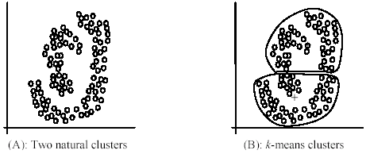
Weaknesses of k-means: Hyper-Ellipsoid Clusters
The k-means algorithm is not suitable for discovering clusters that are not hyper-ellipsoids (or hyper-spheres)
+

Slide 23
Hierarchical Agglomerative Clustering

Slide 24
Hierarchical Agglomerative Clustering (1/8)
Start with each point in its own cluster
Repeatedly merge the clusters of the closest two points
Notes:
jellyroll

Slide 25
Hierarchical Agglomerative Clustering (2/8)
Start with each point in its own cluster
Repeatedly merge the clusters of the closest two points
Notes:
jellyroll

Slide 26
Hierarchical Agglomerative Clustering (3/8)
Start with each point in its own cluster
Repeatedly merge the clusters of the closest two points
Notes:
jellyroll

Slide 27
Hierarchical Agglomerative Clustering (4/8)
Start with each point in its own cluster
Repeatedly merge the clusters of the closest two points
Notes:
jellyroll

Slide 28
Hierarchical Agglomerative Clustering (5/8)
Start with each point in its own cluster
Repeatedly merge the clusters of the closest two points
Notes:
jellyroll

Slide 29
Hierarchical Agglomerative Clustering (6/8)
Start with each point in its own cluster
Repeatedly merge the clusters of the closest two points
Notes:
jellyroll

Slide 30
Hierarchical Agglomerative Clustering (7/8)
Start with each point in its own cluster
Repeatedly merge the clusters of the closest two points
Notes:
jellyroll

Slide 31
Hierarchical Agglomerative Clustering (8/8)
Start with each point in its own cluster
Repeatedly merge the clusters of the closest two points
Notes:
jellyroll

Slide 32
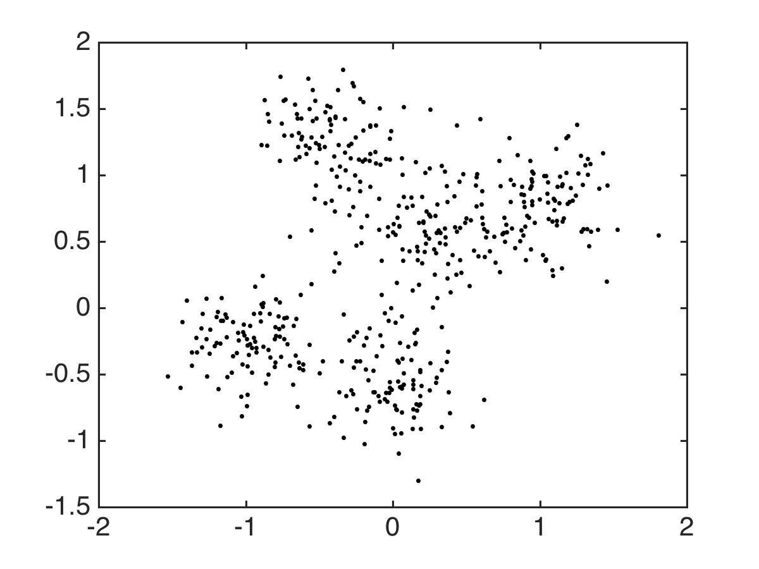
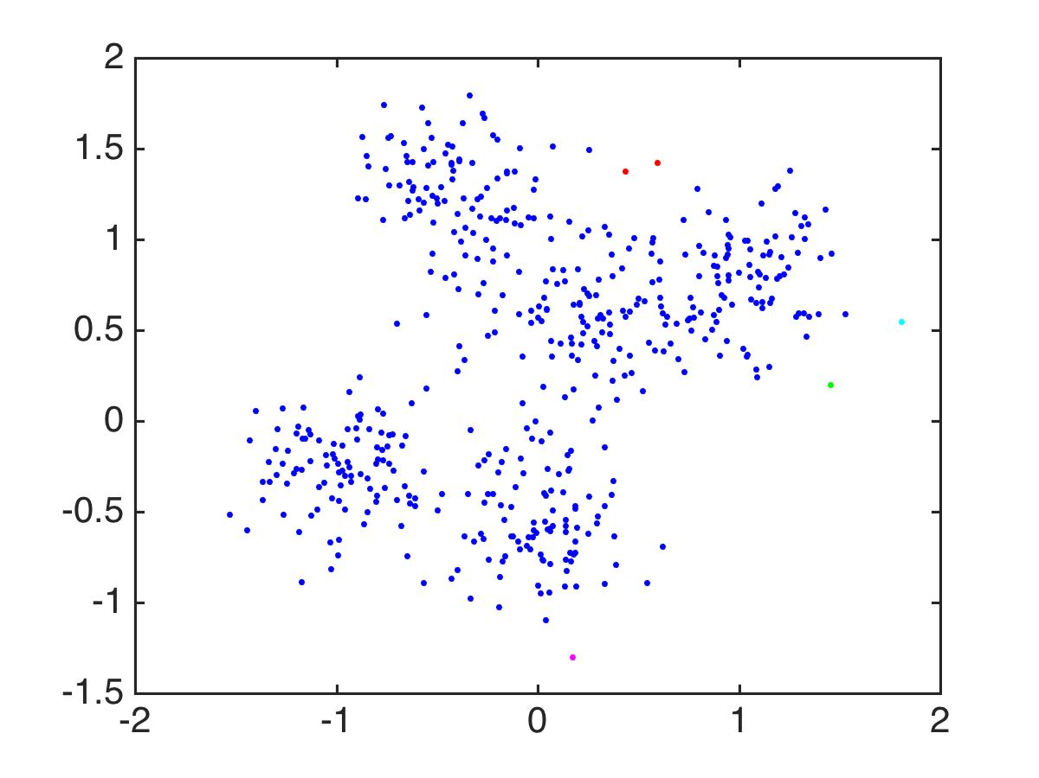
Hierarchical Agglomerative Clustering (1/2)

Slide 33
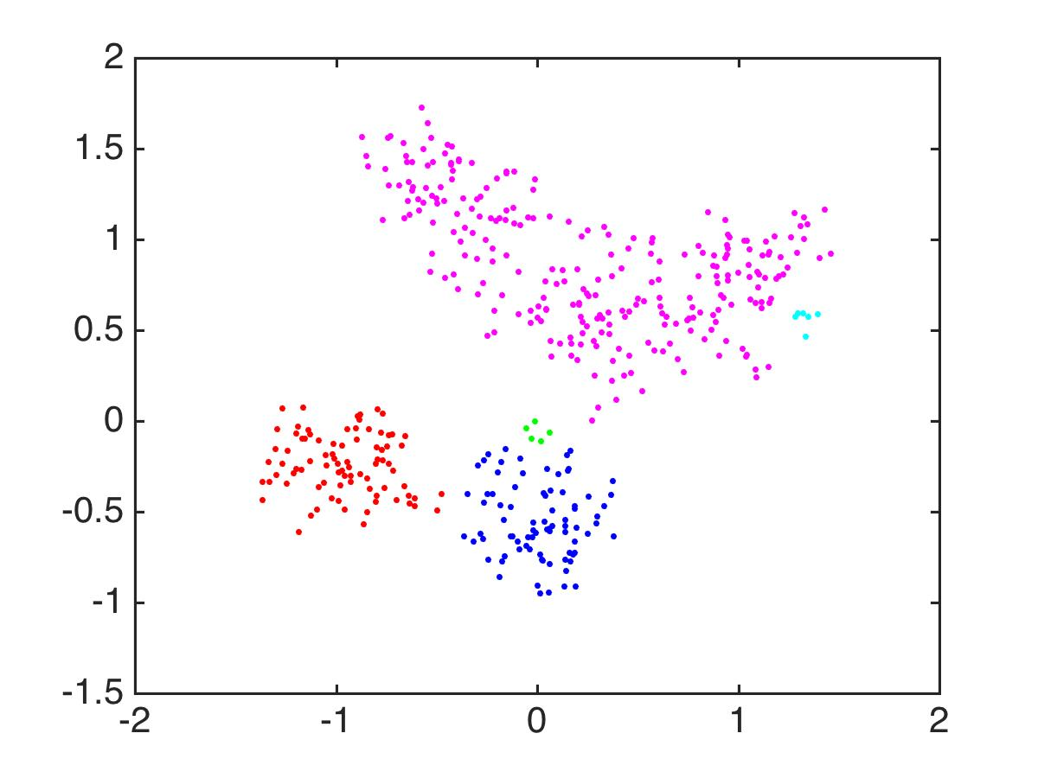
Hierarchical Agglomerative Clustering (2/2)
Notes:
So that’s sort of far from perfect. This algorithm is just not meant for these kind of overlapping spherical clusters. It does much better with these separated but twisty clusters. Long skinny clusters, no problem for HAC. Anyway.

Slide 34
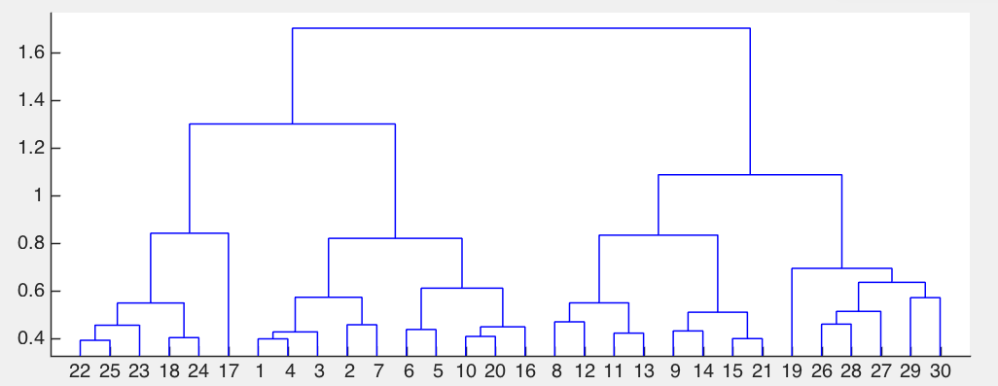
Dendrogram for Hierarchical Agglomerative Clustering (1/3)
Notes:
HAC produces these dendrograms that tell you what clusters are being merged.

Slide 35
Dendrogram for Hierarchical Agglomerative Clustering (2/3)
7
Notes:
HAC produces these dendrograms that tell you what clusters are being merged.

Slide 36
Dendrogram for Hierarchical Agglomerative Clustering (3/3)
2
Notes:
HAC produces these dendrograms that tell you what clusters are being merged.

Slide 37
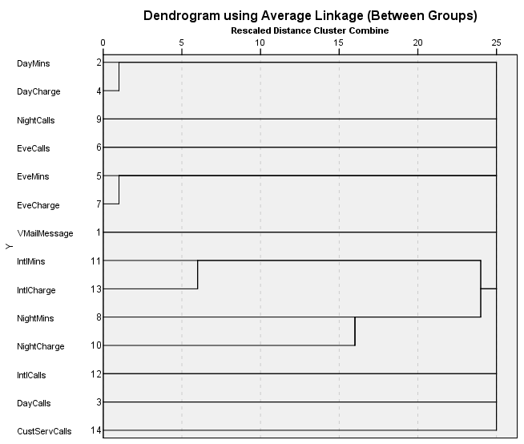
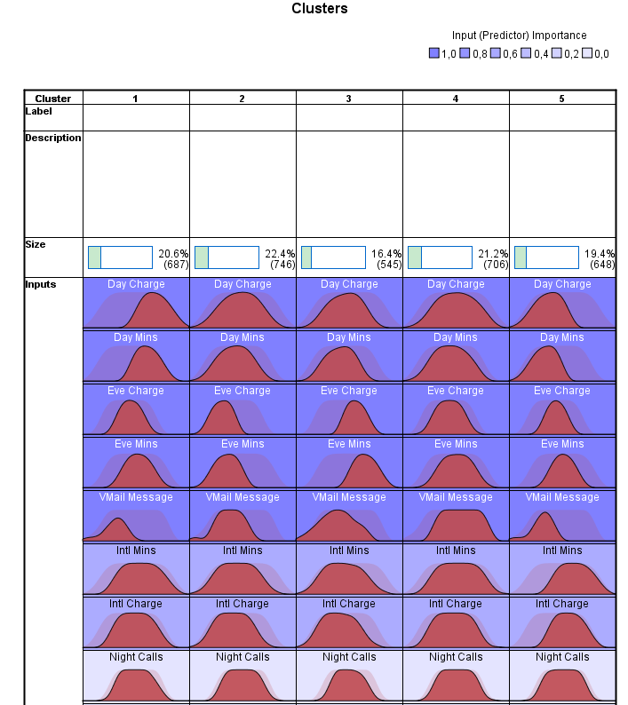
Further Cluster Algorithms..
Hierarchical Clustering
Dendogram of
hierarchical clustering
Is not recommended for a high number of cases
Uses metric and categorical variables as input
Does not determine optimal number of clusters
Advantage that any measure of distance can be used
Two-Step Clustering
Most prominent algorithm
Uses metric and categorical variables as input
Combines K-Means and hierarchical approaches
Determines optimal number of clusters
Allows separation of outliers
Two-step clustering
results

Slide 38
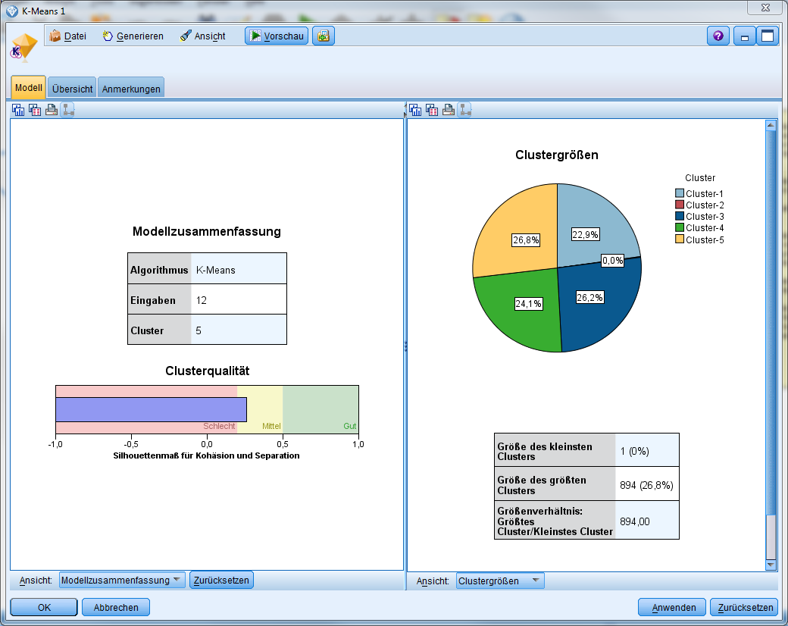
How to Evaluate Clustering Results?
Silhouette as Method of Clustering Validation
Silhouette defines for an observation how well it is allocated to the next two nearest clusters
The Silhouette coefficient visualizes the silhouette of the complete data set as well as single clusters and the data set
i= observation
a(i)=average dissimilarity of i with all other observation within the same cluster
We interpret a(i) as how well i is assigned to its cluster (the smaller the value, the better the assignment)
We then define the average dissimilarity of point i to a cluster c as the average of the distance from i to points in c
Let b(i) be the lowest average dissimilarity of i to any other cluster which i is not a member.
The cluster with this lowest average dissimilarity is said to be the "neighbouring cluster" of i because it is the next best fit cluster for point i
s(i) = 0.3
Cluster Structuring | Values of s(i)
strong | 0.75 < s(i) ≤ 1
Medium | 0.5 < s(i) ≤ 0.75
Weak | 0.25 < s(i) ≤ 0.5
No structure | 0 < s(i) ≤ 0.25

Slide 39

You learnt so far…
Despite its weaknesses, k-means is still the most popular algorithm due to its simplicity, efficiency
There is no clear evidence that any other clustering algorithm performs better in general although they may be more suitable for some specific types of data or applications
Hierarchical Agglomerative Clustering is useful when clusters are well-separated. (This means data that are close together should be in the same cluster.)
For K-means, one needs to choose the number of clusters (try a few different ones). For hierarchical clustering, one chooses when to stop merging clusters
Comparing different clustering algorithms is a difficult task. No one knows the correct clusters!

